Slide 1
Welcome Teachers to the 2020-2021 Year!
Model Nearpod Lesson (Science)
Mr. Dolce

Slide 2
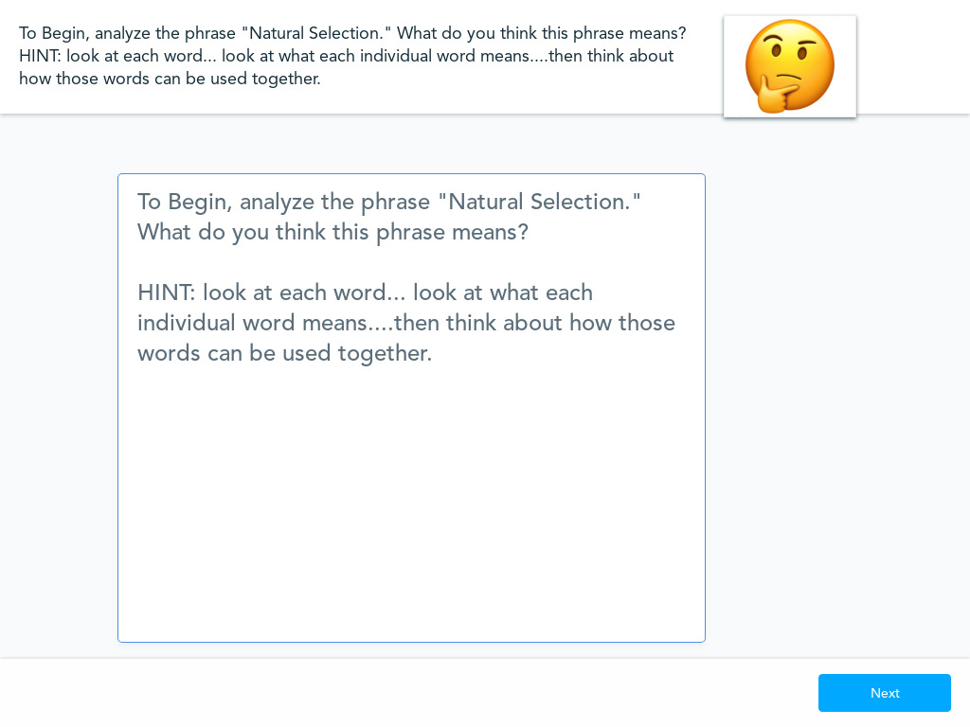

Slide 3
https://learn.genetics.utah.edu/content/evolution/advantage/
Watch the simulation from my screen and start brainstorming your observations. Be ready to share your observations in the next activity!

Slide 5
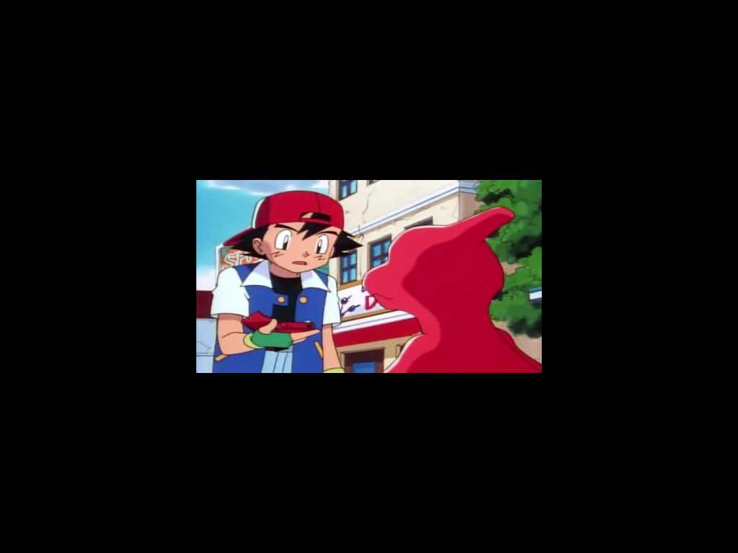

Slide 7
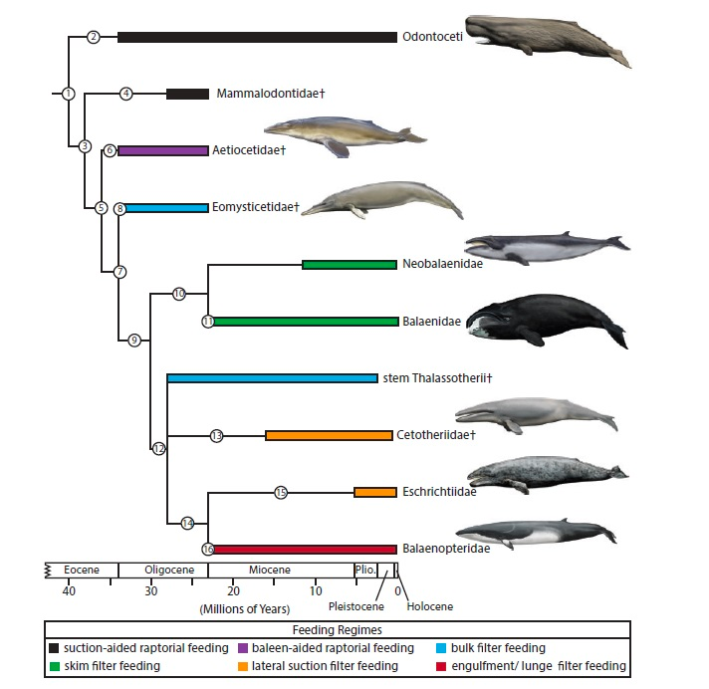
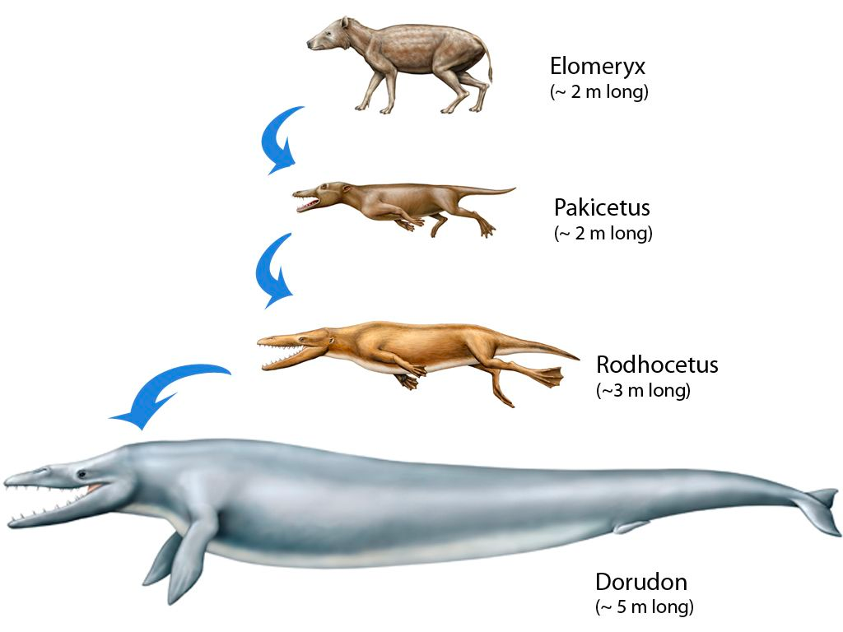
NATURAL SELECTION OBJECTIVE: I CAN IDENTIFY THE STEPS OF NATURAL SELECTION AND DESCRIBE HOW IT LEADS TO THE EVOLUTION OF A SPECIES
Standards: 3.1f-h

Slide 8
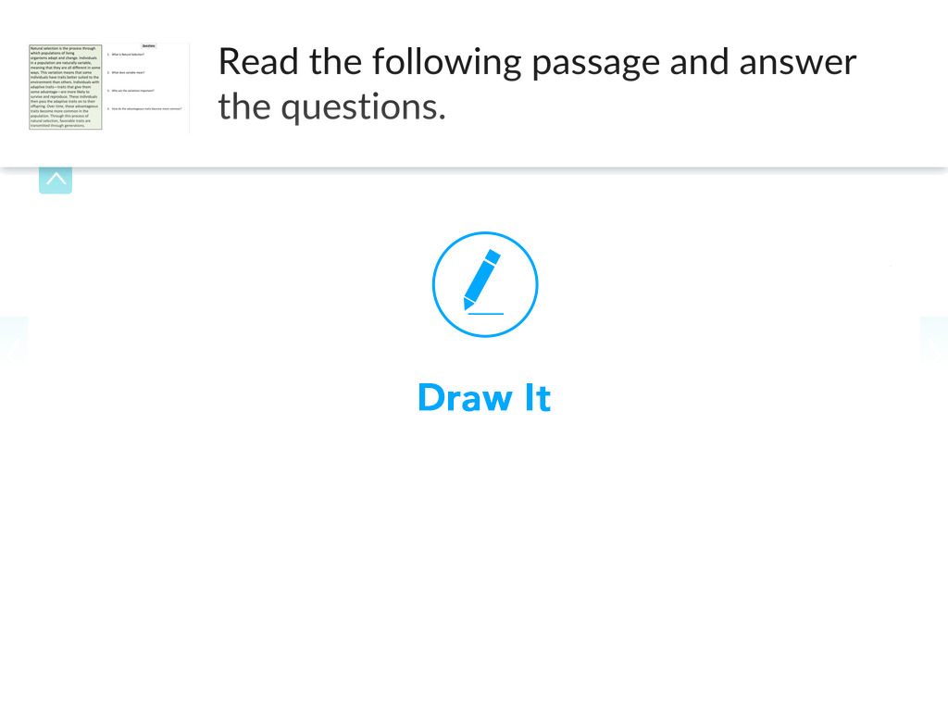

Slide 9
MINI LESSON
Evolution: A process in which species change over time caused by natural selection.
Natural Selection: A process in which organisms that are better adapted to their environment tend to survive and produce more offspring. Referred to as “Survival of the fittest”
children
Necessary Factors for Natural Selection
Variation must exist: Differences amongst traits in the population must exist. (Ex. Fur color, height, horns)
Trait must be heritable: The variation must be coded in DNA and be able to be passed down to offspring (Ex. Coded in DNA of a gamete)
Reproductive advantage: One of the variants must be better adapted to survive, therefore, the frequency of that trait increases over time! (Ex. White fur camouflages with snow, allows organism to avoid predators and survive to make more offspring with white fur)
Number
Slide 2

Slide 10
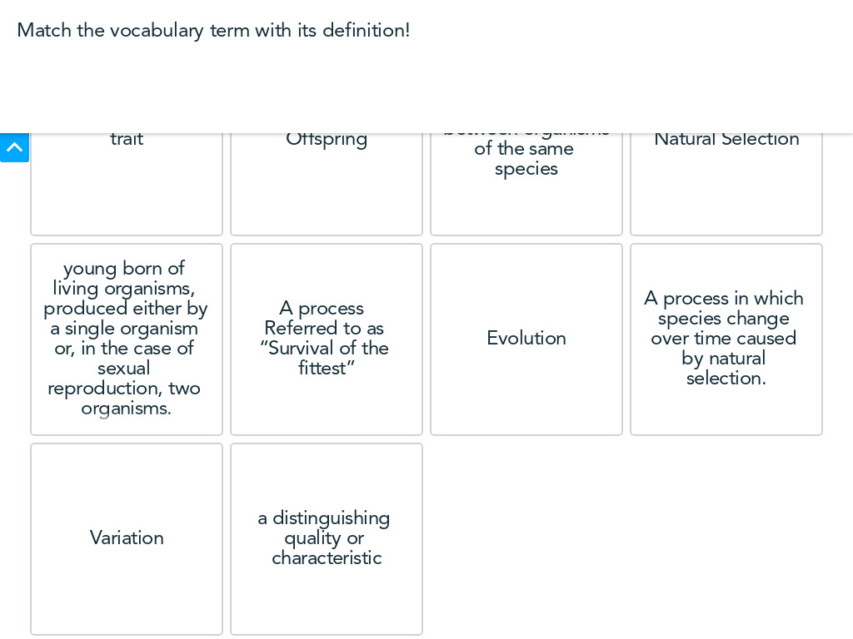

Slide 11
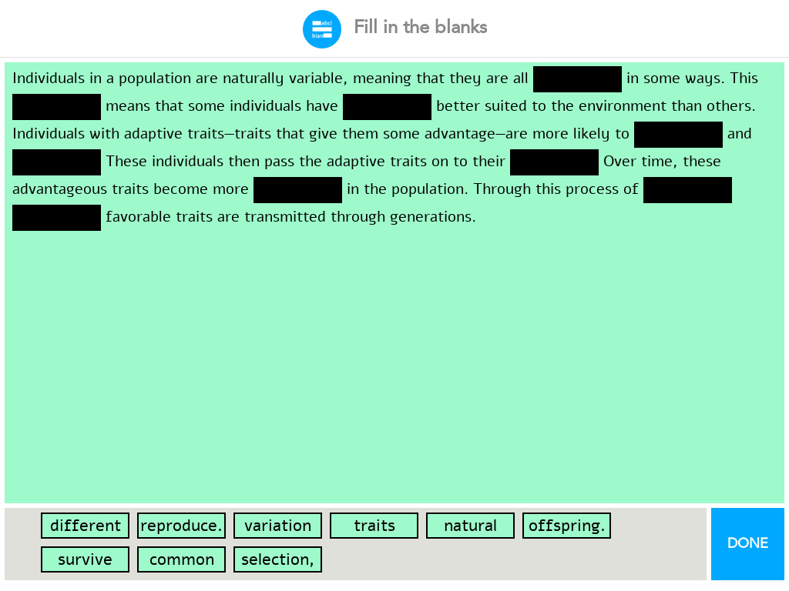

Slide 12
Watch as I model another simulation!
https://phet.colorado.edu/en/simulation/natural-selection

Slide 13
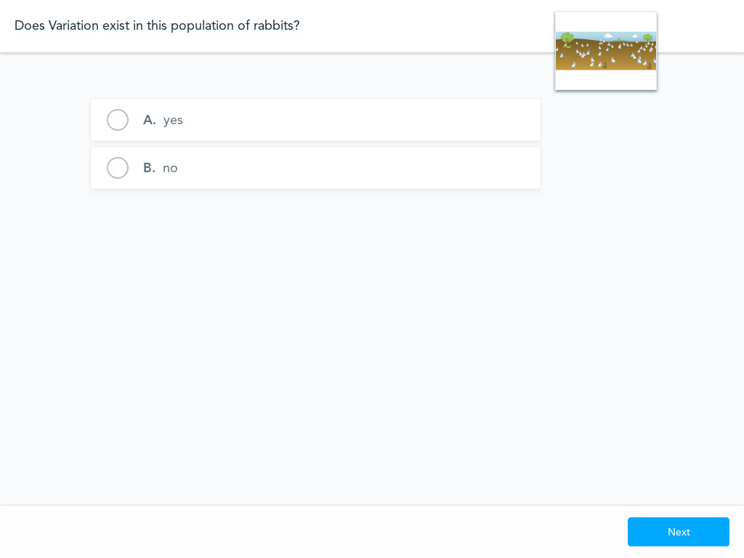

Slide 14
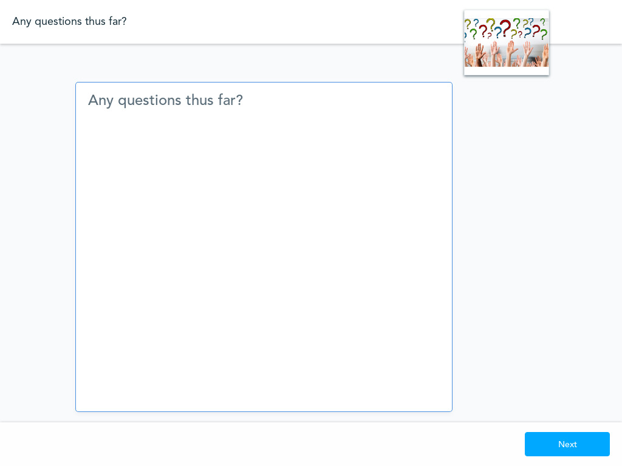

Slide 15
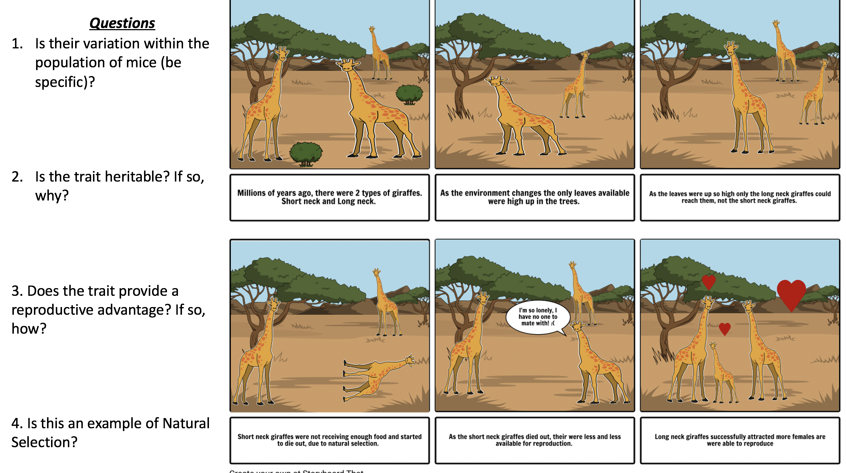

Slide 17
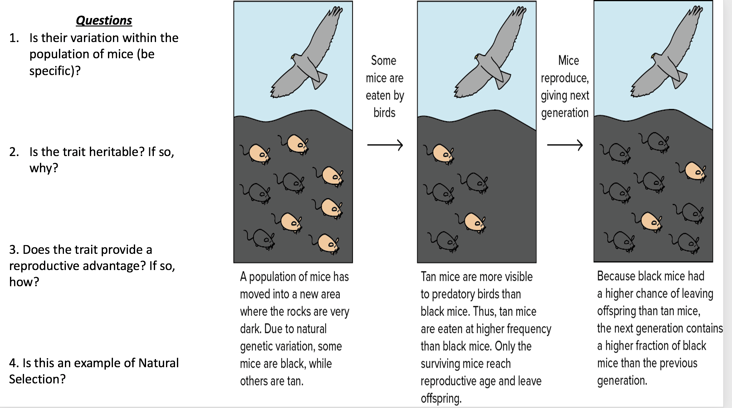

Slide 18
REGENTS “MUST KNOW FACTS”
Variations in populations come from Mutations and Sexual Reproduction (Meiosis)
In order to changes in DNA to be heritable, they must occur in Gametes (sperm/egg)!
For Natural Selection and Evolution to occur, there must be variations within the population!
Natural Selection causes the frequency of the advantageous trait to increase over time!
number
helpful
Go up
Regents Buzz Words
Increase in favorable traits
Increase of advantageous traits
Survival of the fittest
Bacterial Resistance! (they love asking questions about how bacteria has evolved bacterial resistance!...refer to slide 6)
Slide 7

Slide 19
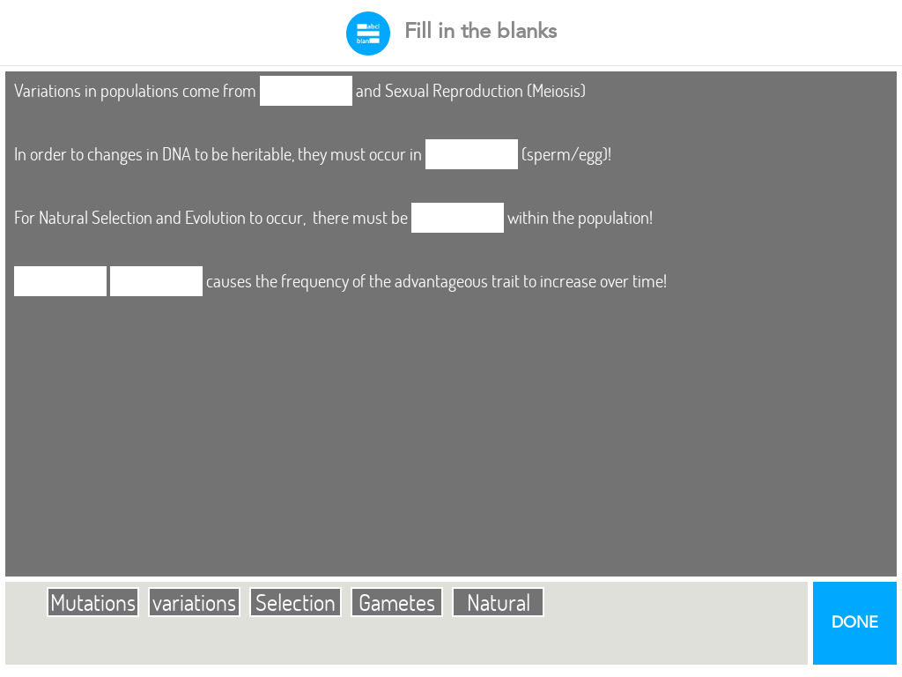

Slide 21
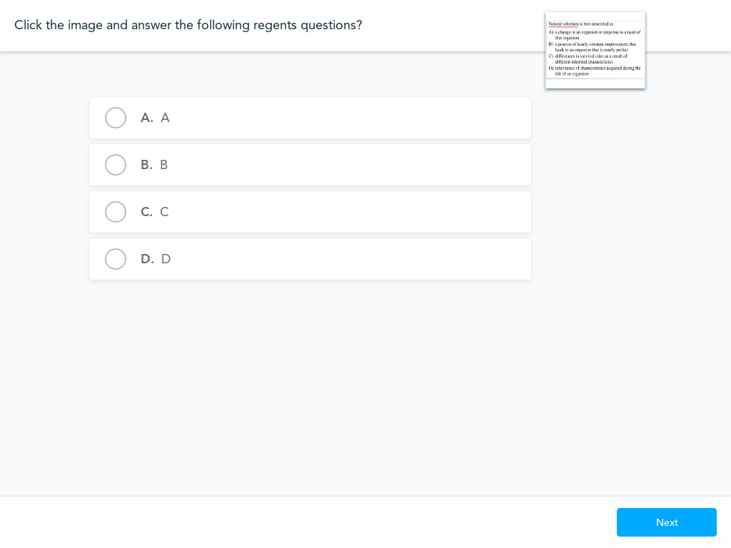

Slide 22
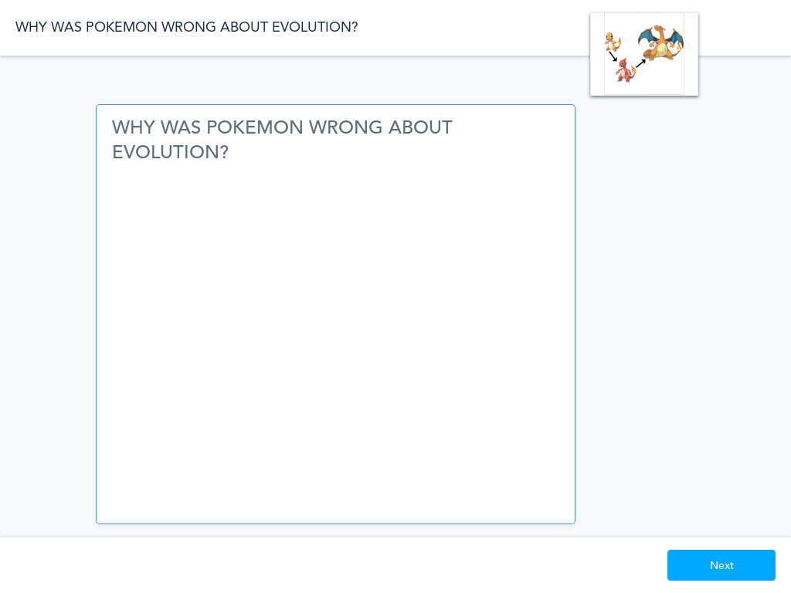

Slide 23
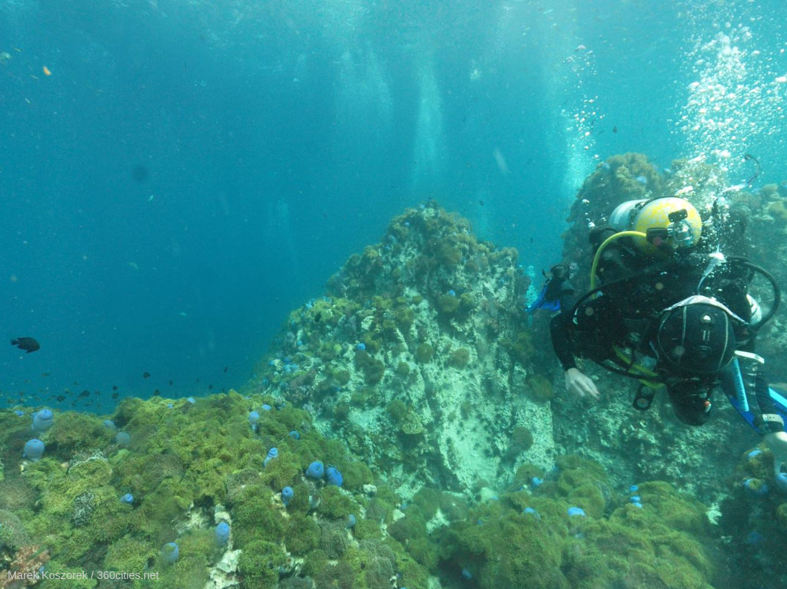

Slide 25
We have concluded our Academic Portion of today's Lesson! Now we will move into the social/emotional aspect of the lesson.

Slide 26
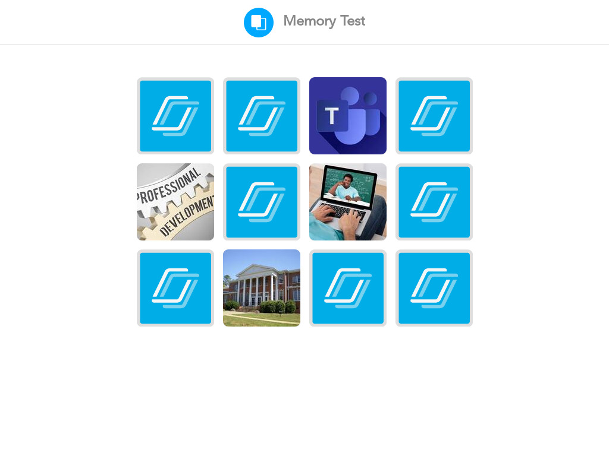
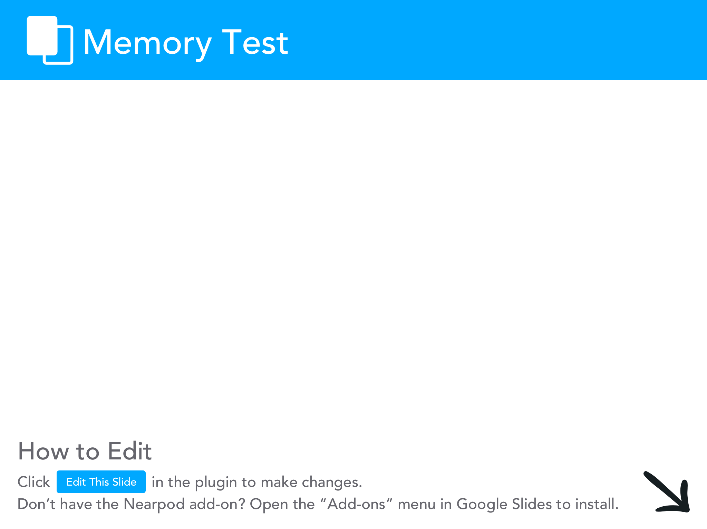

Slide 27
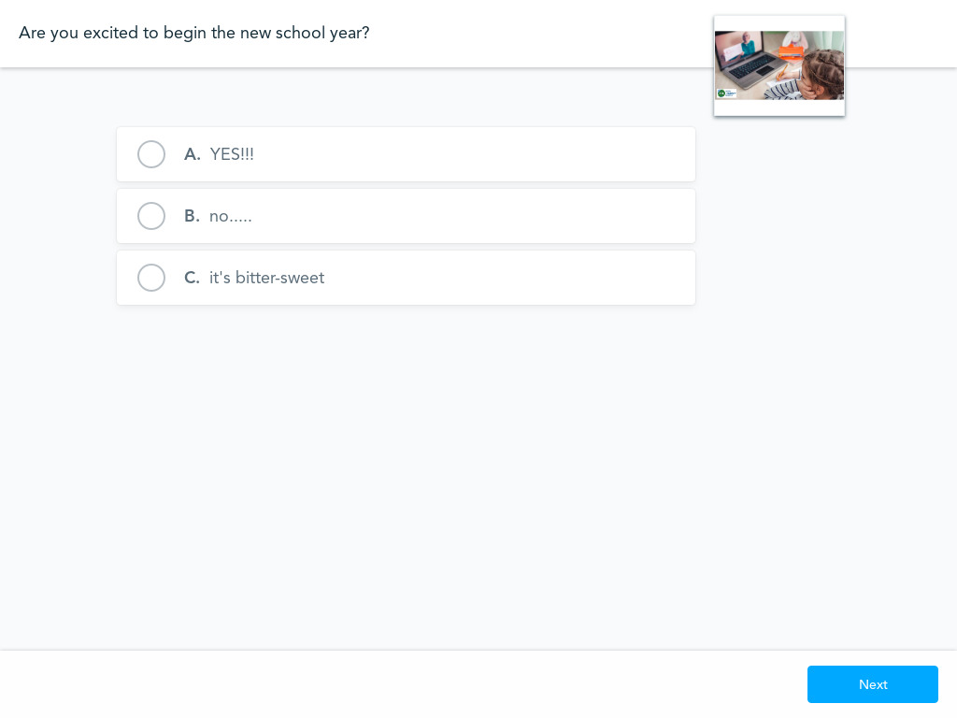

Slide 30
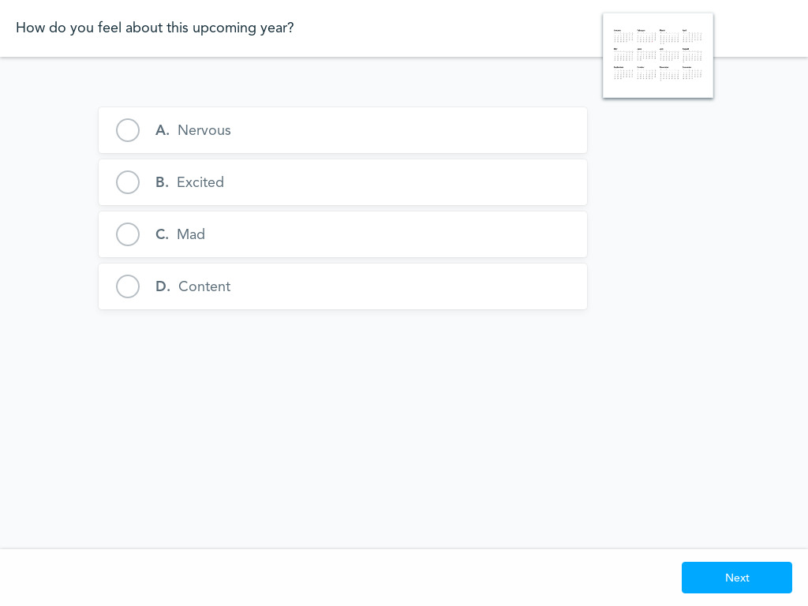

Slide 31
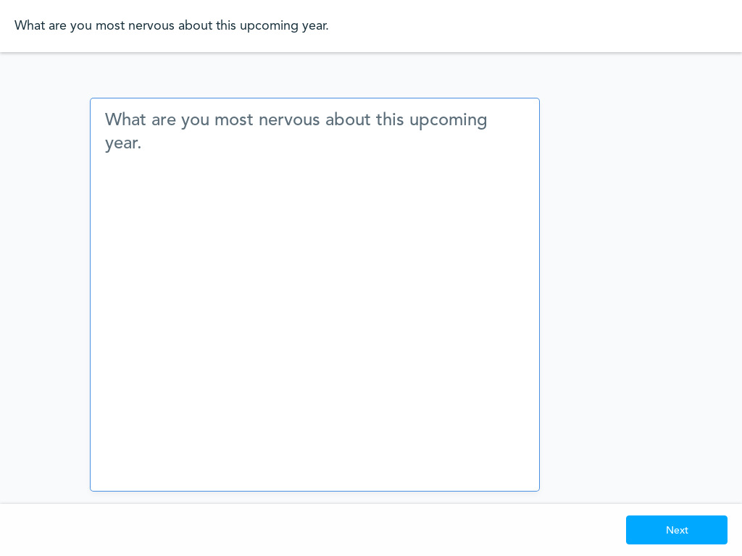

Slide 32
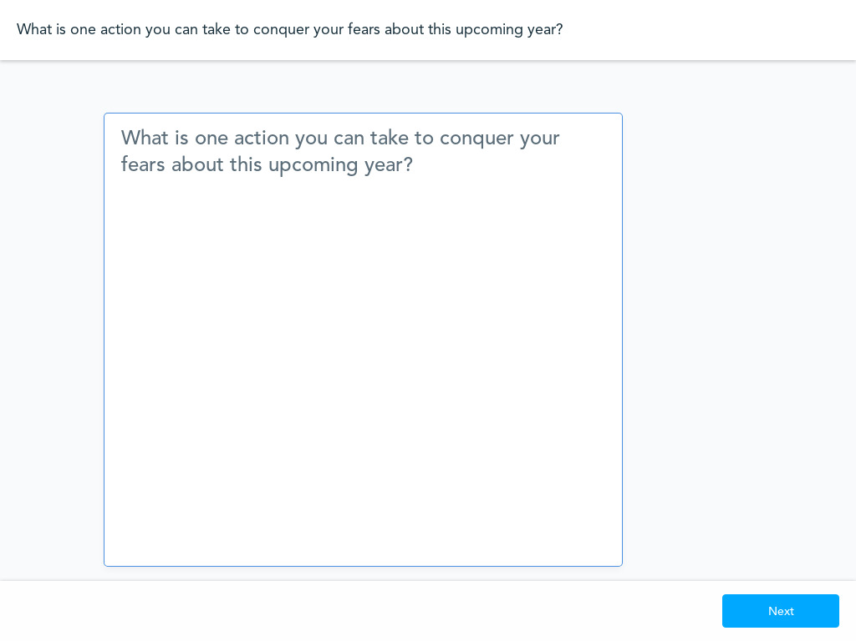

Slide 34
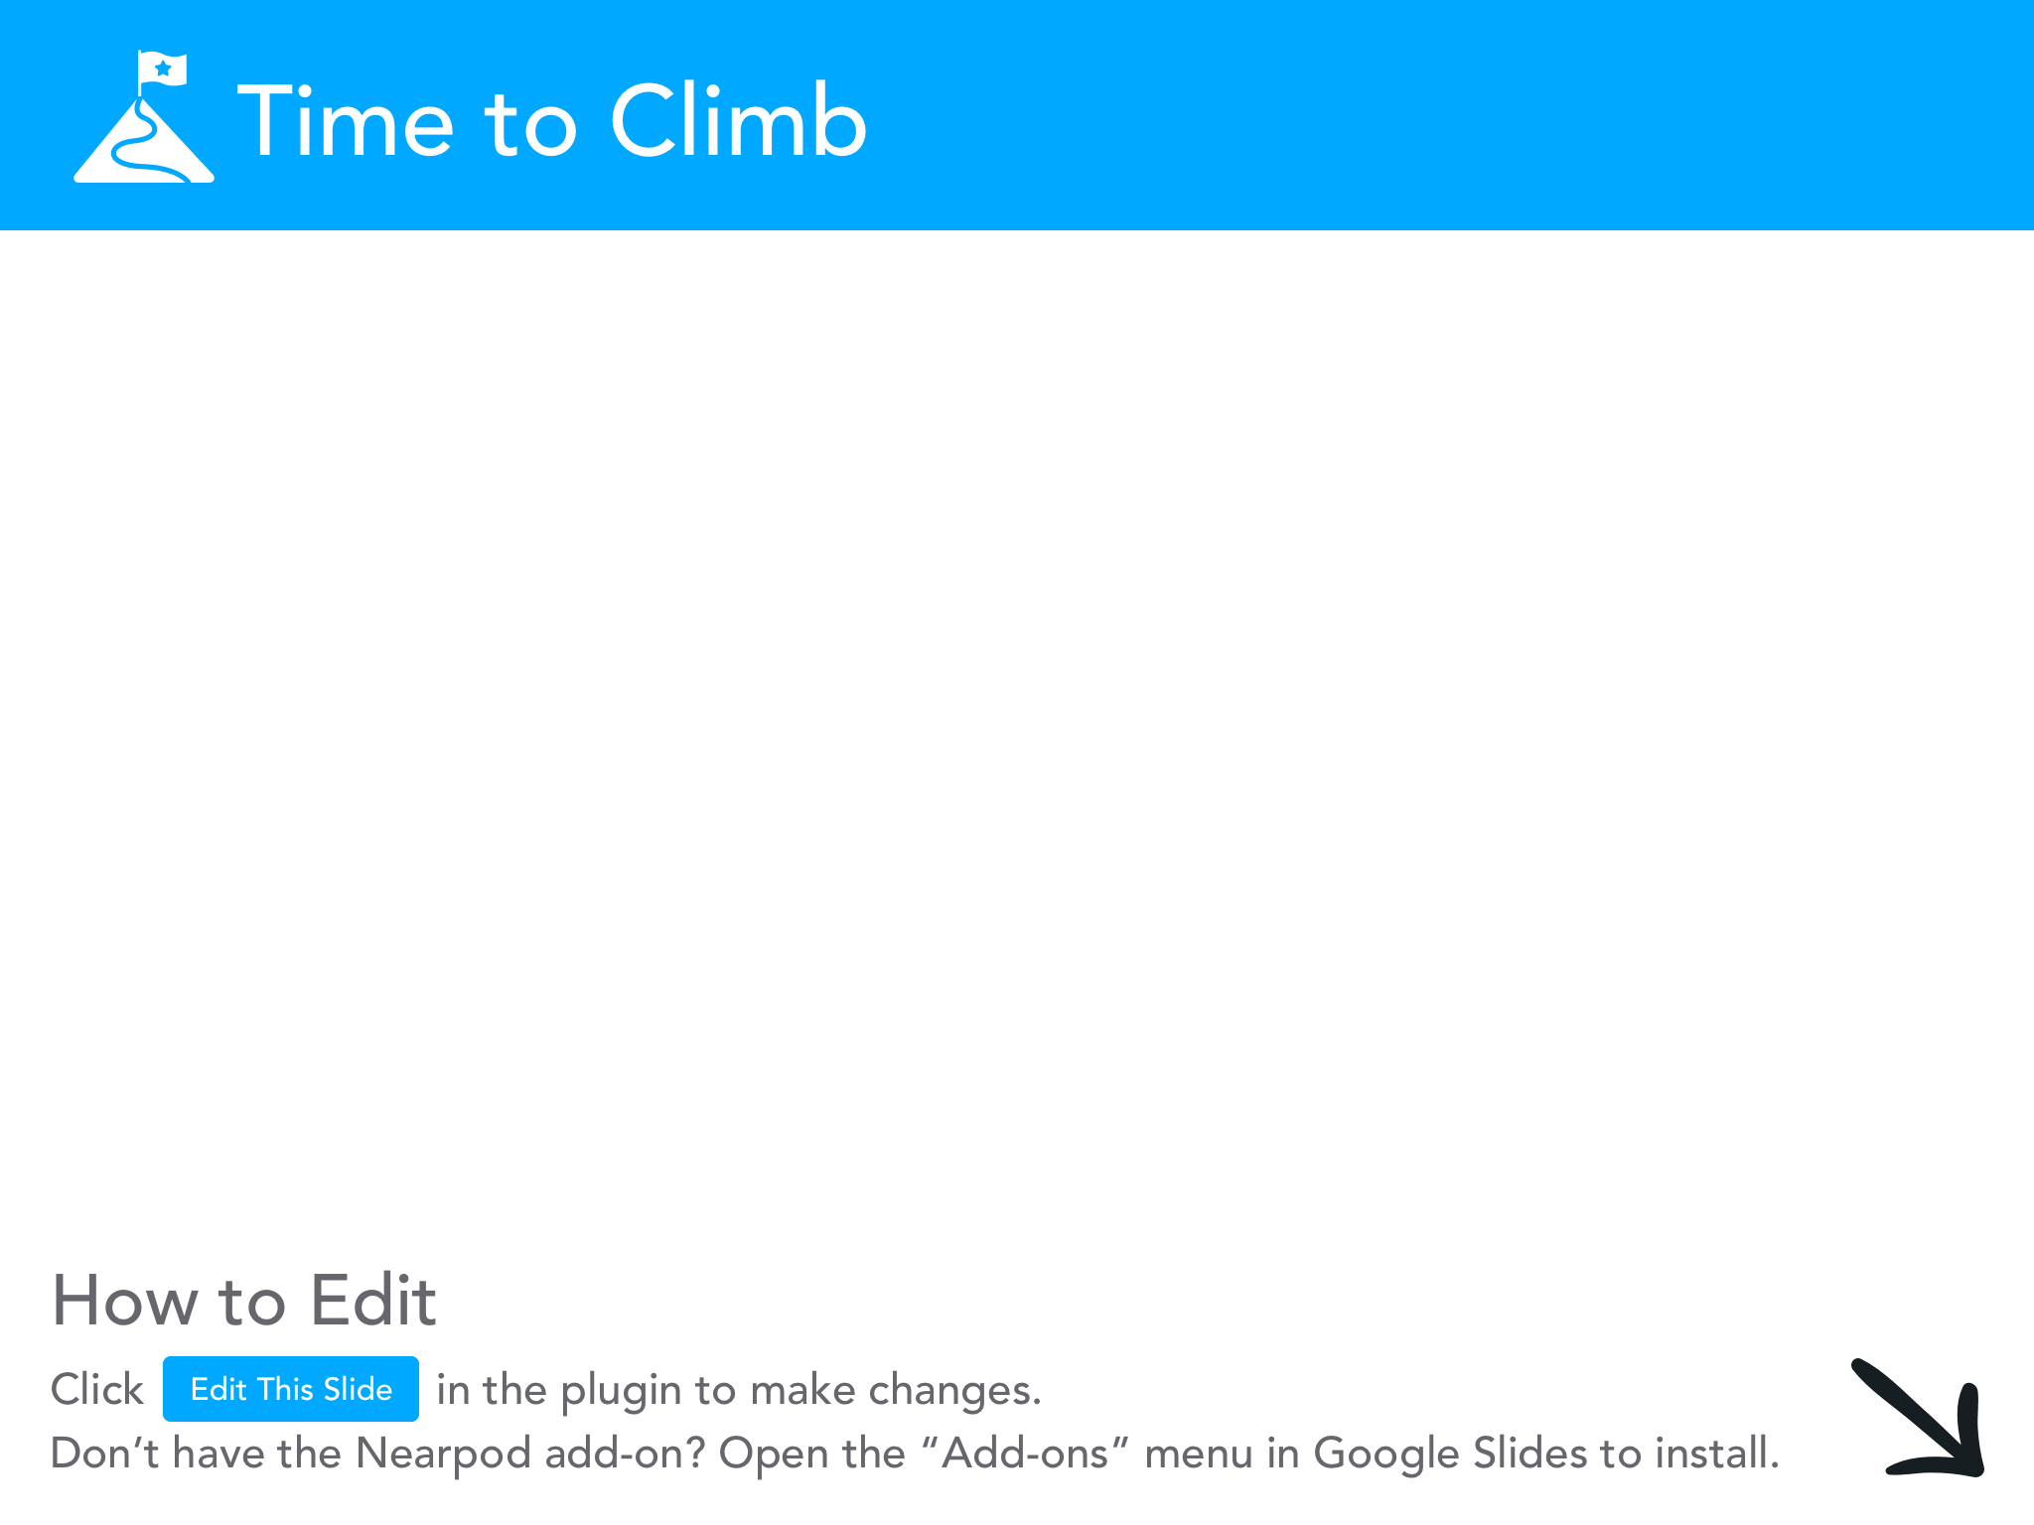

Slide 35
THE END!

